Slide 1
Web Service Explorer and Using End Point

Slide 2
Module Overview
In this Module, we will learn the following:
Using Web Service Explorer
Using Endpoint
What is Wsimport
Wsimport Revisited

Slide 3
Using the Web service Explorer
How to launch Web Service Explorer in Eclipse
In Eclipse we need to install WTP plugin to get web service explorer visible on main window.
For this first we will open eclipse and go to window tab and click on eclipse marketplace and search for WTP. It will list available tools to download WTP. Can select
And install.
After downloading we will test web service with wsdl.
We will understand how to use the Web Service Explorer to test a Web service via native WSDL and SOAP. This example will explain how to use the Web Services Explorer to invoke operations on a Web service.
Duration:10 min
Launch the Eclipse WTP workbench.
click File > Import. The Import wizard opens.
Select Web Service and click Next. The Web service import wizard opens.
Click Finish.

Slide 4
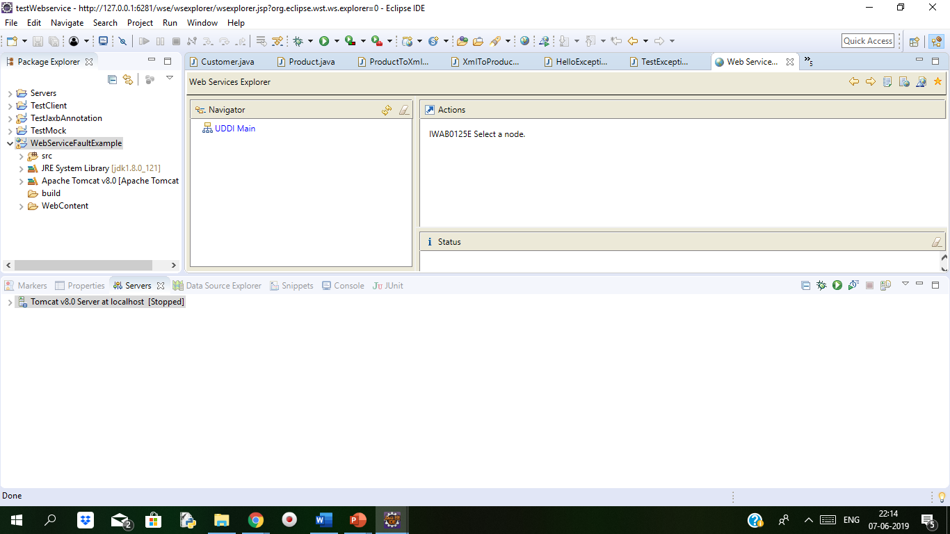
Demo: Using Web Service Explorer
Below is image of the Web Services Explorer when we open. By selecting a registry on the Web Service Publication page of the Web service Import wizard, we can see the registry which can be displayed in the Navigator pane.

Slide 5
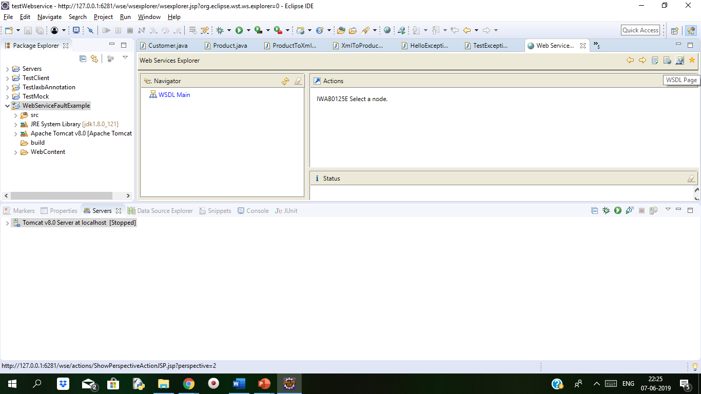
Demo: Using Web Service Explorer Cont..
In the Web Service Explorer's toolbar (top-right), click on the WSDL Page icon,
Click on third icon

Slide 6
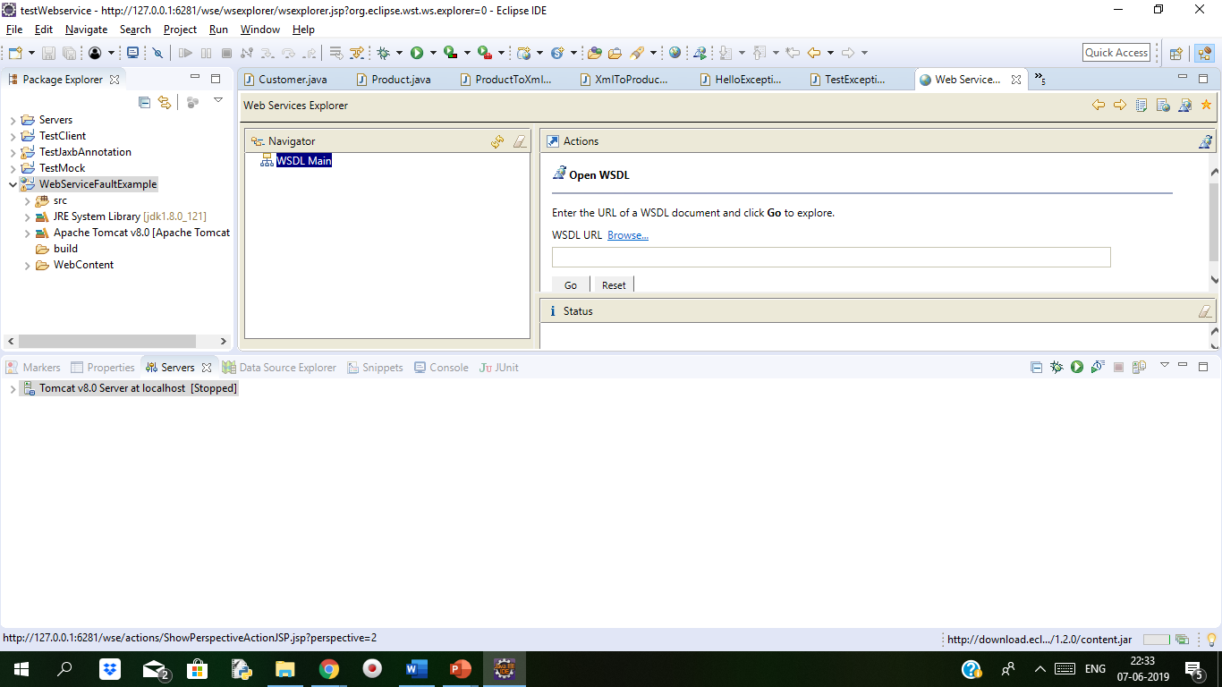
Demo: Using Web Service Explorer Cont..
Click on the WSDL Main icon. We can see the below screen:

Slide 7
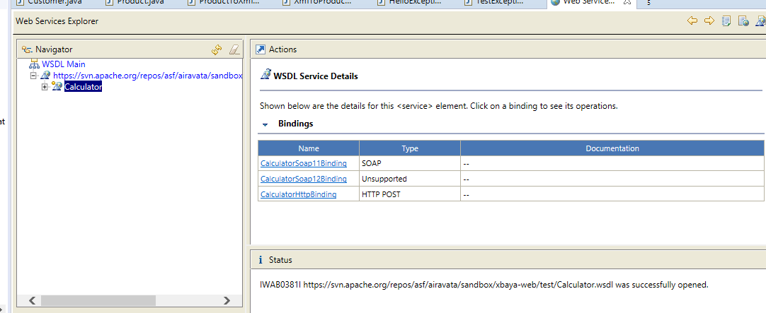
Demo: Using Web Service Explorer Cont..
In the WSDL URL field, enter the URL https://svn.apache.org/repos/asf/airavata/sandbox/xbaya-web/test/
Calculator.wsdl
then click on Go . Following will display:

Slide 8
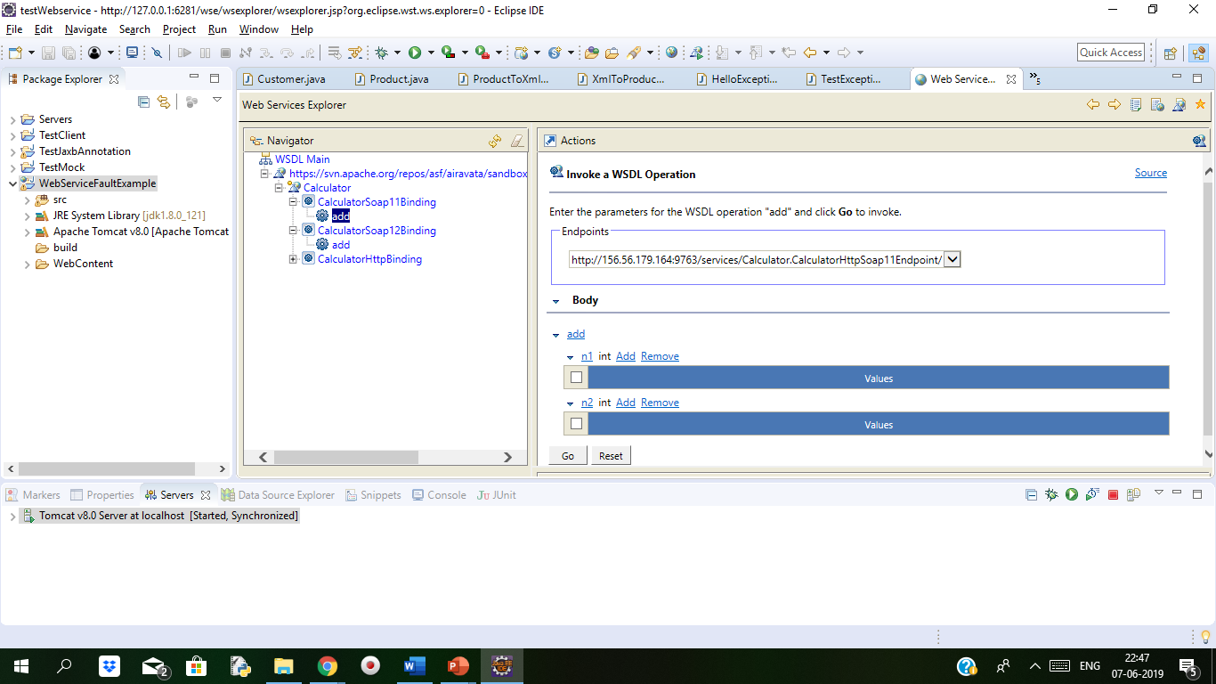
Demo: Using Web Service Explorer Cont..
Under Operations in the right hand pane, click on add . We can see below:

Slide 9
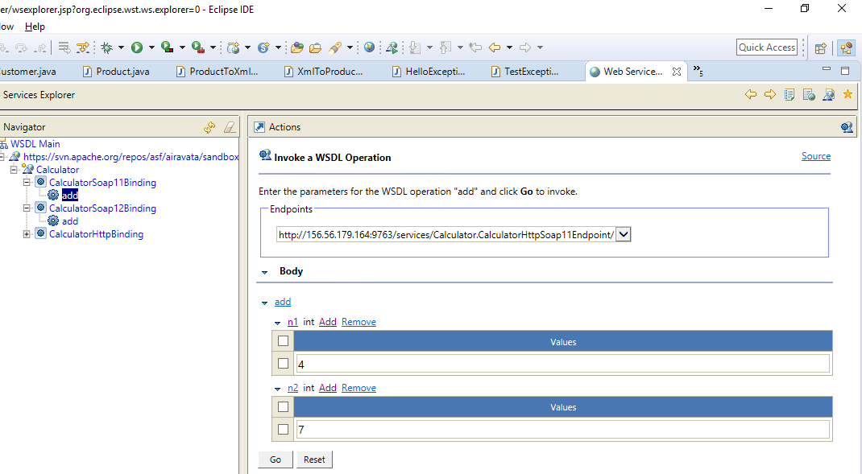
Demo: Using Web Service Explorer Cont..
In the add int section of soap body if we pass some values to we get the result.

Slide 10
Using Web Service Explorer
What is the Web Services Explorer?
It is a JSP web application which is hosting on the Apache Tomcat servlet engine that contained within Eclipse.
The WSDL Explorer helps us to test and explore WSDL documents.
This type of integration allows the Web Services Explorer to access resources in the workspace, to write resources into the workspace, and launch various Web services wizards.
The Web Services Explorer provides three key services to the user:
It provides comprehensive support to discover Web services in WS-Inspection 1.0 documents, and in UDDI v2 or v3 registries using the UDDI v2 protocol.
It gives comprehensive support to publish Web services to UDDI v2 or v3 registries using the UDDI v2 protocol.
It gives comprehensive support to browse and invoke Web services natively via their WSDL and XSD.

Slide 11
Using Endpoint
JAX-RPC enables a Web Service endpoint to be developed using either a Java Servlet or Enterprise JavaBeans (EJB) component model.
Web service endpoint is deployed on either the Web container or EJB container which based on the corresponding component model.
These endpoints are designed using a WSDL document. This WSDL document can be published in public or private registry, though those registries is not required.
A client uses this WSDL document and invokes the Web service endpoint.
For invoking a heterogeneous Web service endpoint,a JAX-RPC client can use stubs-based, dynamic proxy or dynamic invocation interface (DII) programming models.
WSDL specifies a grammar that describes Web services as a group of communication endpoints, called ports.
Notes:
The Java API for XML-based RPC (JAX-RPC) makes it possible to write an application in the Java programming language that uses SOAP to make a remote procedure call (RPC). JAX-RPC can also be used to send request-response messages and, in some cases, one-way messages. In addition to these conventional uses, JAX-RPC makes it possible for an application to define its own XML schema and to use that schema to send XML documents and XML fragments. The result of this combination of JAX-RPC and XML Schema is a powerful computing tool.

Slide 12
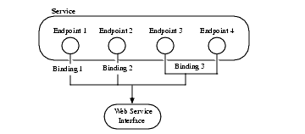
Using Endpoint Cont..
Using the Endpoint Explorer dialog, we can send arbitrary requests and also can analyse server responses.
When we start SoapUI,the Endpoint Explorer dialog is displayed by default.
If we want to open it manually, click Endpoint Explorer on the main toolbar:

Slide 13
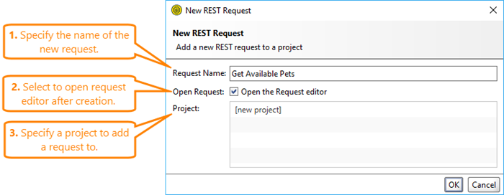
Using Endpoint Cont..
To send a request:
Select an HTTP method. We can use any of the supported HTTP methods: GET, POST, PUT, DELETE, HEAD, OPTIONS, TRACE, PATCH, PROPFIND, LOCK, UNLOCK, COPY and PURGE.
Also we can mention headers in the Authentication & Headers panel. If the method supports payload bodies, we can mention one in the Body panel.
Mention the URL where we want to send the request.
Click Send.
Analyse the server response in the Response (RAW) panel.
Click Save Request to add the sent request to a test.
Save Request
To add the sent request to a test, click Save Request:

Slide 14
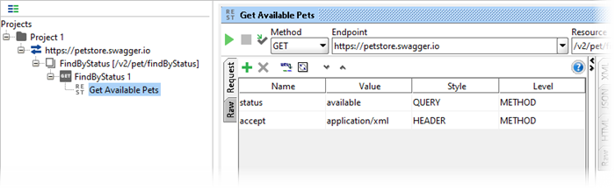
Using Endpoint Cont..
1. In the New REST Request dialog, specify the name of our new request. 2. If we want to open the Request editor after creating the request, select the Open Request option. 3. Select the project to which we want to add the request. 4. Click OK.
The new request will be added to the project:

Slide 15
Wsimport Revisited
Wsimport is a command line tool which is provided by JAX-WS to generate all the web services artifacts. Those Web service artifacts includes web service client support code which will take care of including qualified name and URL in the client supporting class.

Slide 16
Wsimport Revisited Cont..
The wsimport command generates the following JAX-WS portable artifacts. These artifacts can be packaged in a WAR file with the WSDL and schema documents and the endpoint implementation to be deployed. The wsimport command also provides a wsimport Ant task.
Service Endpoint Interface (SEI)
Service
Exception class is mapped from wsdl:fault (if any)
Async Response Bean is derived from response wsdl:message (if any)
JAXB generated value types (mapped java classes from schema types)
To start the wsgen command, do the following:
Windows:
\bin\wsimport.bat -help

Slide 17
Wsimport Revisited Cont..
Syntax
wsimport [options] <wsdl>
The following table lists the wsimport options.
Option | Description
-d <directory> | Specify where to place generated output files
-b <path> | Specify external JAX-WS or JAXB binding files (Each <file> must have its own -b)
-B <jaxbOption> | Pass this option to JAXB schema compiler
-catalog | Specify catalog file to resolve external entity references, it supports TR9401, XCatalog, and OASIS XML Catalog format. Please read the documentation of catalog and see catalog sample.
-extension | Allow vendor extensions (functionality not specified by the specification). Use of extensions may result in applications that are not portable or may not interoperate with other implementations
-help | Display help
-httpproxy:<host>:<port> | Specify an HTTP proxy server (port defaults to 8080)
-keep | Keep generated files
-p | Specifying a target package via this command-line option, overrides any wsdl and schema binding customization for package name and the default package name algorithm defined in the specification
-s <directory> | Specify where to place generated source files
-verbose | Output messages about what the compiler is doing
-version | Print version information
-wsdllocation <location> | @WebServiceClient.wsdlLocation value
-target | Generate code as per the given JAX-WS specification version. version 2.0 will generate compliant code for JAX-WS 2.0 spec.
-quiet | Suppress wsimport output

Slide 18
Wsimport Revisited Cont..
wsimport -p stockquote http://stockquote.example.com/quote?wsdl
This will generate the Java artifacts and we can compile them by importing the
http://stockquote.example.com/quote?wsdl

Slide 19
Summary
In this Module, we have learnt the following:
Using Web Service Explorer
Using Endpoint
What is Wsimport
Wsimport Revisited

Slide 20

Thank You

